Slide 1

BHAI PARMANAND INSTITUTE OF BUSINESS STUDIES
DEPARTMENT OF COMPUTER APPLICATION
MINOR PROJECT(MCA-169)
Submitted To:
MR.DEEPAK SHARMA
(Assistant Professor)
Submitted by:
Rahul Singh
Roll No-03011404420
Manu Madathil Joseph
Roll No- 50211404420

Slide 2
budgetary
Made By
Rahul Singh and Manu Joseph

Slide 3
Introduction
1.Brief Description of the System under Study:
The System in the process of deployment is a Webpage called Budgetary Control
It provides user a platform from where he/she can easily with less effort can perform various action like savings and expenditure which are time consuming and common.
Basically the idea behind this procedure is to provide a one step solution for the user to calculate, plan and keep a track of his/her income and expenses

Slide 4
objectives
The Main Objectives Of Budget Control Can Be Described as Follows:
Estimation Of Income And Expenses
A budget provides a realistic estimate of income and expenses for a
period and of the financial position at the close of the period.
Action Plan
Budget provides a coordinated plan of action which is design to achieve
the estimates reflected in the budget
Comparing The Results
Another objective of a Budget is to provide a comparison of actual results
with those budgeted and an analysis and Interpretation of deviations by
Areas of responsibility to indicate courses of corrective actions and to
lead to improvement in future plans.

Slide 5
Providing Guidance
Budget helps to provide a guide for management decision in
adjustingplans and objectives if there is an uncontrollable
changes in conditions
Forecasting And Decision Making
It provides a ready basis for making forecasts during the budget
period to guide management in making day to day decisions.

Slide 6
FEATURES
Accurate spending categories
Enough spending categories
Accurate income projections
Categories for irregular expenses
A-line item for savings
Tracking for cash purchases
Percentage display for expenses

Slide 7
MINIMUM HARDWARE requirements
Virtual Memory Processor : 32 Bit, Pentium – IV
Ram : 256 MB
Hard Disk : 40 GB
Monitor : SVGA Monitor (800 * 600Resolutions)
Clock Speed : 266 MHZ
Floppy Drive : 1.44 MB

Slide 8
MINIMUM SOFTWARE requirements
Operating System : Windows 2000/XP.
Supported Browser-
Firefox
Google Chrome
HTML Editor-
Notepad
TextEdit For Macintosh
Vi or Emacs for Linux

Slide 9
ABOUT language used
Java script
CSS(cascading style sheet)
html
Reference
www.tutorialspoint.com
www.w3school.com
www.youtube.com

Slide 10
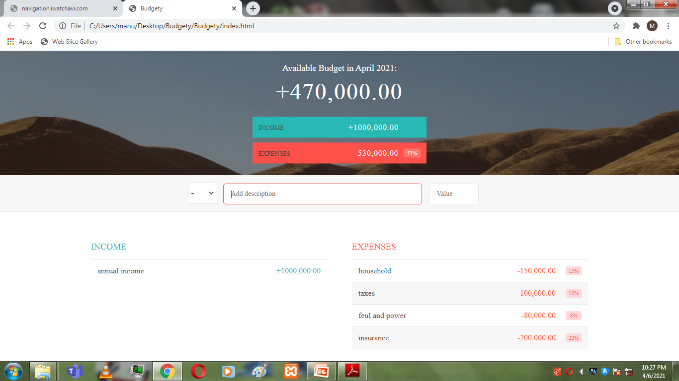
Webpage

